Slide 1
Curve Modeling
Bézier Curves

Slide 2
Introduction
In practice, designers or users usually do not care about the underlying mathematics and equation.

Slide 3
Introduction
A system that supports users to design curves must be:
Intuitive: We expect that every step.
Flexible: The system should provide the users with more control for designing and editing the shape of a curve.
Easy: The way of creating and editing a curve should be easy.

Slide 4
Introduction
Unified Approach: The way of representing, creating and editing different types of curves (e,g., lines, conic sections and cubic curves) must be the same.
Invariant: The represented curve will not change its geometry under geometric transformation (translation, rotation, …)

Slide 5
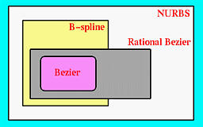
Introduction
Bézier, B-spline and NURBS curves advantage:
A user layouts a set of control points for the system.
A user can change the positions of some control points and some other characteristics for modifying the shape of curve.

Slide 6
Introduction
If necessary, a user can add control points.
They are very geometric, intuitive.
The transition from curve to surface will not cause much difficulty.

Slide 7
Bézier
Curves

Slide 8
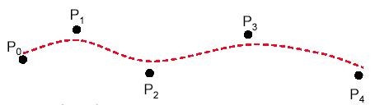
Bézier Curves
Bézier splines are:
spline approximation method;
useful and convenient for curve and surface design;
easy to implement;
available in Cad system, graphic package, drawing and painting packages.

Slide 9
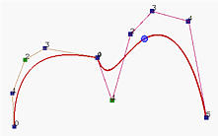
Bézier Curves
In general, a Bézier curve section can be fitted to any number of control points.
The number of control points to be approximated and their relative position determine the degree of the Bézier polynomial.

Slide 10
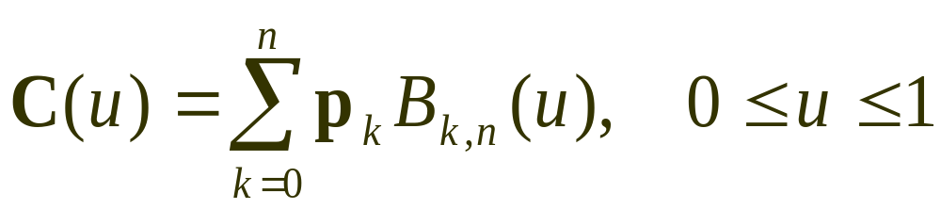
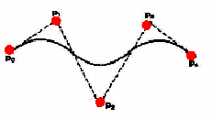
Bézier Curves
Given n+1 control point positions:
These coordinate points can be blended to produced the following position vector C(u), which describes the path of an approximating Bézier polynomial function between P₀ and P_{n}.

Slide 11
Properties
of
Bézier ‍Curves

Slide 12

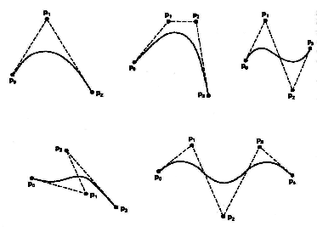
Properties of a Bézier ‍Curve
The degree of a Bézier curve defined by n+1 control points is n:
Parabola Curve
Cubic Curve
Cubic Curve
Cubic Curve

Slide 13
Properties of a Bézier ‍Curve
The curve passes though the first and the last control point C(u) passes through P₀ and P_{n}.

Slide 14
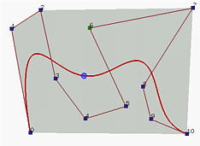
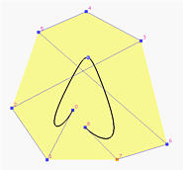
Properties of a Bézier ‍‍‍Curve
Bézier curves are tangent to their first and last edges of control polyline.
2
7
4
6
5
1
3
3
8
2
0
5
8
9
6
0
4
10
1
7

Slide 15
Properties of a Bézier Curve
The Bézier curve lies completely in the convex hull of the given control points.
Note that not all control points are on the boundary of the convex hull. For example, control points 3, 4, 5, 6, 8 and 9 are in the interior. The curve, except for the first two endpoints, lies completely in the convex hull.

Slide 16
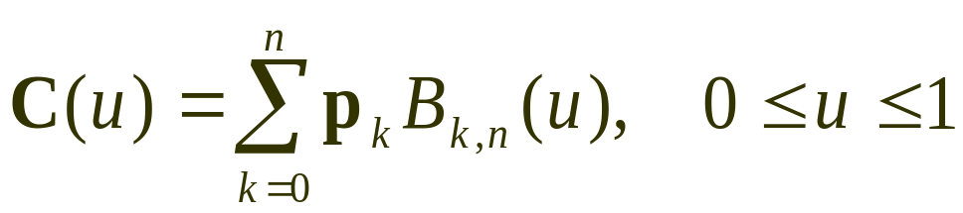
Bézier Curves
The point that corresponds to u on the Bézier curve is the "weighted" average of all control points, where the weights are the coefficients B_{k,n}(u).

Slide 17
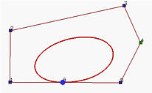
Design Techniques Using Bézier ‍Curve
(Closed Curves)
‍‍Closed Bézier curves are generated by specifying the first and the last control points at the same position.
4
5
3
2
0
8
6
1
7
‍‍Note: Bézier curves are polynomials which cannot represent circles and ellipses.

Slide 18
Construction
of
Bézier ‍Curves

Slide 19
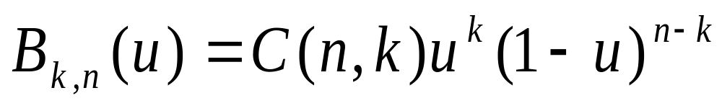
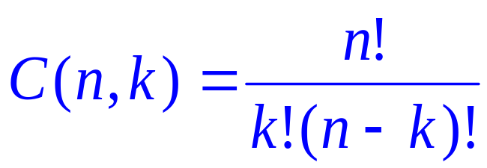
Bézier Curves
Given n+1 control point positions:
The Bézier blending functions are the Bernstein polynomials:
The C(n,k) are the binomial coefficients:

Slide 20
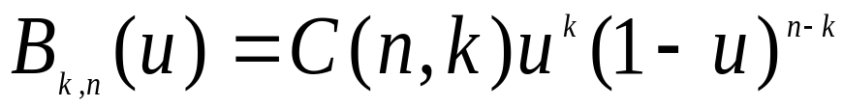
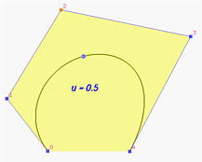
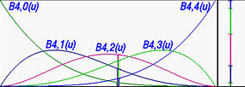
Properties of a Bézier Curve
All basis functions are positive and their sum is always 1

Slide 21
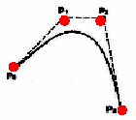
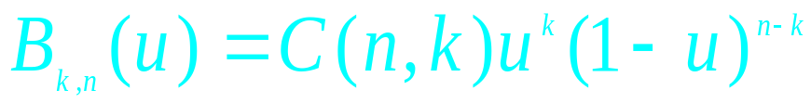
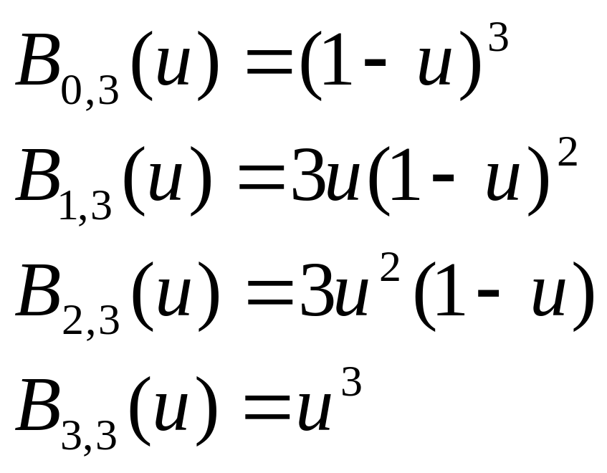
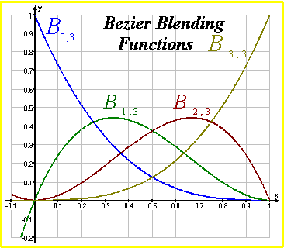

Example
Cubic Bézier Curves
Cubic Bézier curves are generated with four control points.
The four blending functions for cubic Bézier curves (n=3):

Slide 22
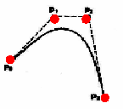
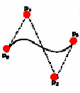
Cubic Bézier Curves
Cubic Bézier curves gives reasonable design flexibility while avoiding the increased calculations needed with higher order polynomials.

Slide 23
Cubic Bézier Curves
Cubic Bézier curves are generated with four control points.
The four blending functions for cubic Bézier curves (n=3):

Slide 24
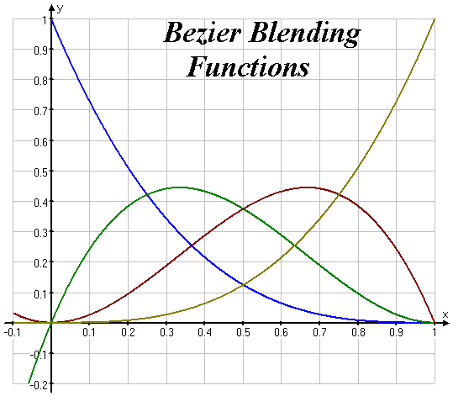
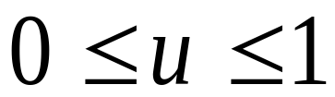
Cubic Bézier Curves
At u=0, B_{0,3}=1, and at u=1, B_{3,3}=1. thus, the curve will always pass through control points P₀ and P₃.
The functions B_{1,3} and B_{2,3}, influence the shape of the curve at intermediate values of parameter u, so that the resulting curve tends toward points P₁ and P₃.
At u=1/3, B_{1,3} is maximum, and at u=2/3, B_{2,3} is maximum.

Slide 25
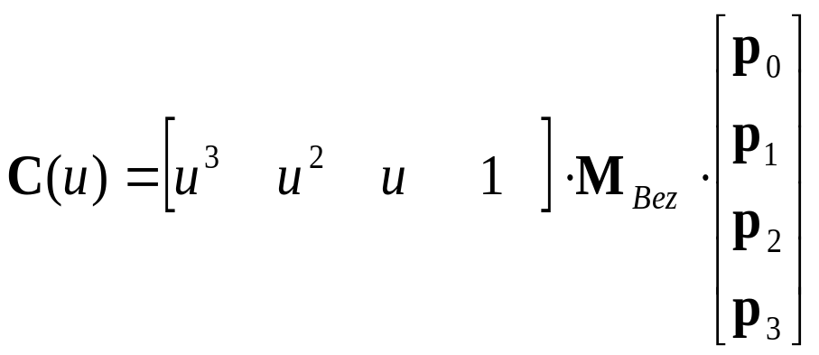
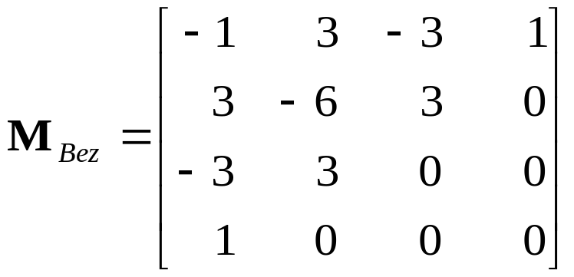
Cubic Bézier Curves
At the end positions of the cubic Bézier curve, The parametric first and second derivatives are:
With C¹ and C² continuity between sections, and by expanding the polynomial expressions for the blending functions: the cubic Bézier point function in the matrix form:

